Slide 1


PYTHON CODING CAMP
Oct 10 2019
Masters in Business Analytics and Information Systems University of South Florida
Graduating May 2020
srikrishnak@mail.usf.edu
813-605-9805

Slide 2
Highest-paid programming and scripting languages in 2018
Language | Average salary | YoY % Increase
1.Golang | $132,827 | N/A
2. Perl | $110,678 | -2.7
3. Shell | $109,518 | 4.0
4. Node.js JavaScript | $105,418 | 3.7
5. Java/J2EE | $105,164 | 2.6
6. TypeScript | $103,680 | 1.7
7. Python | $103,587 | 0.4
8. Ruby | $ 102,086 | -1.2
9. Swift | $ 101,631 | 3.2
10. C# | $101,566 | 1.8
Notes:
https://www.techrepublic.com/article/the-programming-languages-and-skills-that-pay-the-best-in-2019/

Slide 3
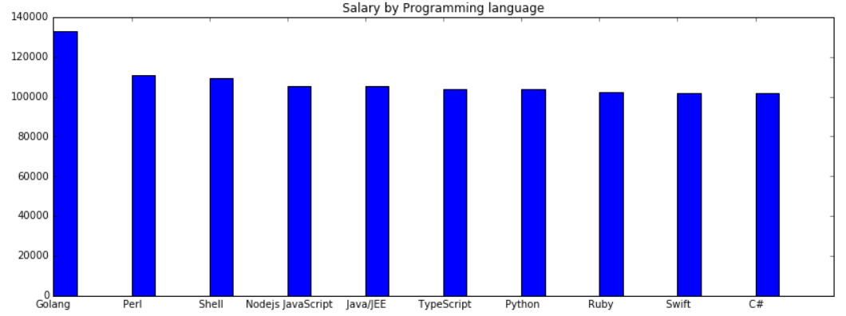
Highest-paid programming and scripting languages in 2018
Graph is better?
Notes:
https://www.codeplatoon.org/the-best-paying-and-most-in-demand-programming-languages-in-2019/
https://www.daxx.com/blog/development-trends/python-developer-salary-usa

Slide 4
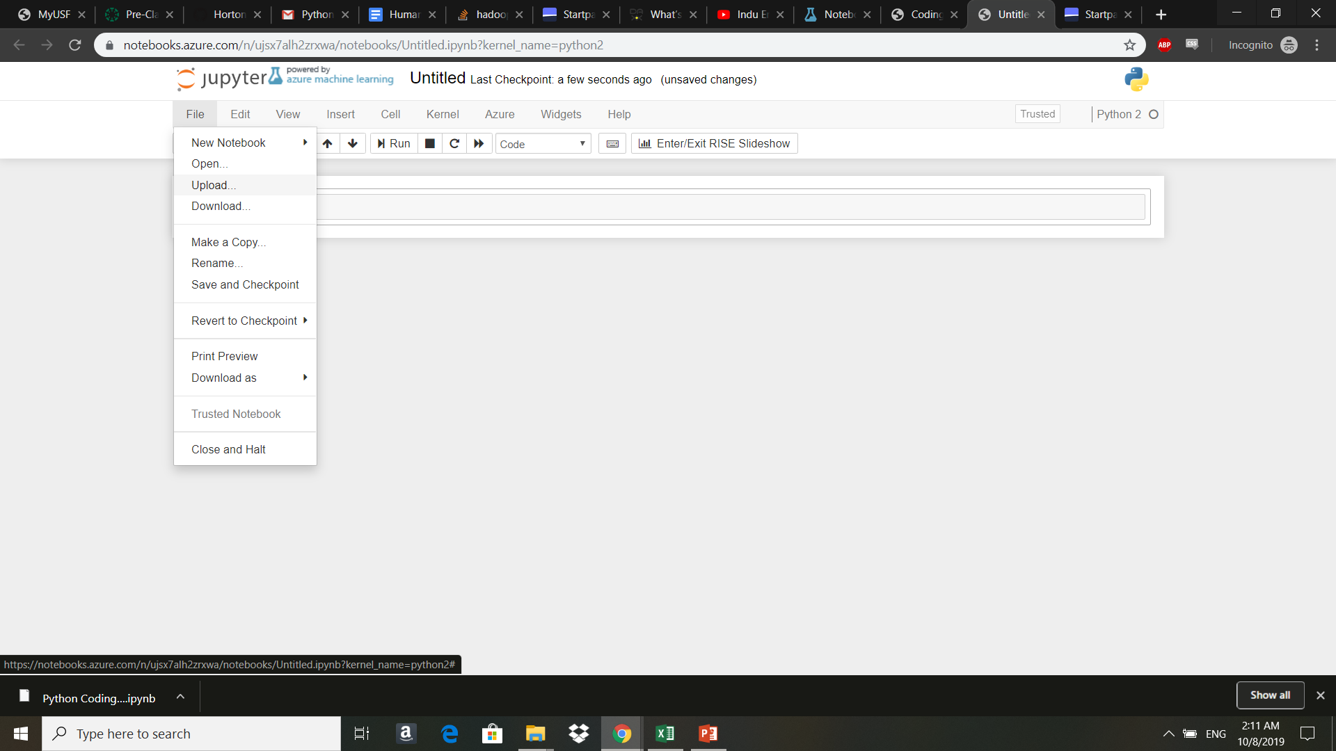
Select /Project folder to upload
Hands-on Programming Follows…

